Slide 1

Vel Tech Rangarajan Dr. Sagunthala R&D Institute of Science and Technology
School of Computing
Department of Computer Science and Engineering
10211CS224 / FULL STACK APPLICATION DEVELOPMENT (JAVA)
PROJECT REVIEW : MILESTONE PROJECT – 1
Date: 02-03-2026
TrackWise: Relational Expense Analytics Platform
SDG: 8 - Decent Work and Economic Growth
Presented By:
P. SIVAPRASAD REDDY – VTU25749 – 23UESE0856.
Courses Handling Faculty:
Dr. S. HEMAMALINI – M.E., Ph.D.,

Slide 2
INTRODUCTION
Background of the Problem: Most people and small businesses track expenses manually or inconsistently, leading to poor financial visibility and decision-making.
Why This Project Is Important: Without structured tracking and analysis, users cannot identify spending patterns or control unnecessary expenses effectively.
Real-World Relevance: Accurate expense analytics helps individuals budget better and enables businesses to maintain financial stability and growth.
Brief Overview of the System: TrackWise is a relational expense analytics platform that stores, organizes, and analyzes financial data to generate meaningful insights and reports.
1
2
3
4
5
6
7
8
9

Slide 3
PROBLEM STATEMENT
Many individuals and small businesses manage expenses using spreadsheets or manual records, which leads to errors and inconsistencies.
Financial data is often scattered across multiple files, making tracking and analysis difficult.
There is no structured relational system linking expenses with categories, dates, and reports.
This lack of integration reduces financial visibility and weakens budgeting decisions.
Existing basic tools focus mainly on data entry and lack advanced analytical features.
Users struggle to identify spending patterns and unnecessary expenses.
Report generation is often manual, time-consuming, and inaccurate.
Therefore, a centralized and automated relational expense analytics platform like TrackWise is required to improve accuracy and decision-making.
1
2
3
4
5
6
7
8
9

Slide 4
OBJECTIVE(S)
To design and develop a relational expense analytics platform that securely stores and categorizes at least 1000+ expense records with structured database integration.
To implement automated reporting and trend analysis features that generate monthly and category-wise financial summaries with accurate data visualization.
To improve budgeting accuracy by enabling automated expense categorization and real-time financial tracking.
To evaluate the performance of the TrackWise platform based on data processing speed, report generation time, and accuracy of financial analytics.
1
2
3
4
5
6
7
8
9

Slide 5
PROPOSED SYSTEM
TrackWise provides a centralized web-based platform that stores all expense data in a structured relational database.
It connects expenses with categories, dates, and user accounts, ensuring organized and consistent data management.
The system automates calculations, report generation, and category-wise summaries, reducing manual work and errors.
Real-time analytics and trend visualization help users quickly understand spending patterns.
It eliminates scattered spreadsheets by integrating data entry, storage, and analysis into one system.
The platform improves accuracy through validation checks and structured database relationships.
Compared to basic tools, TrackWise offers deeper analytical insights instead of simple record-keeping
Overall, it enhances financial visibility, decision-making speed, and long-term budgeting efficiency.
1
2
3
4
5
6
7
8
9

Slide 6
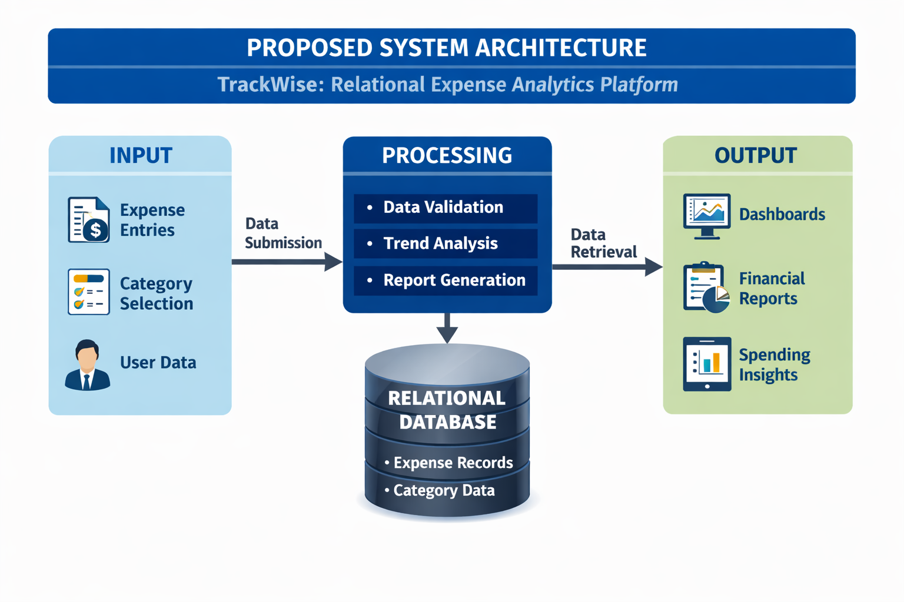
PROPOSED SYSTEM ARCHITECTURE
1
2
3
4
5
6
7
8
9

Slide 7
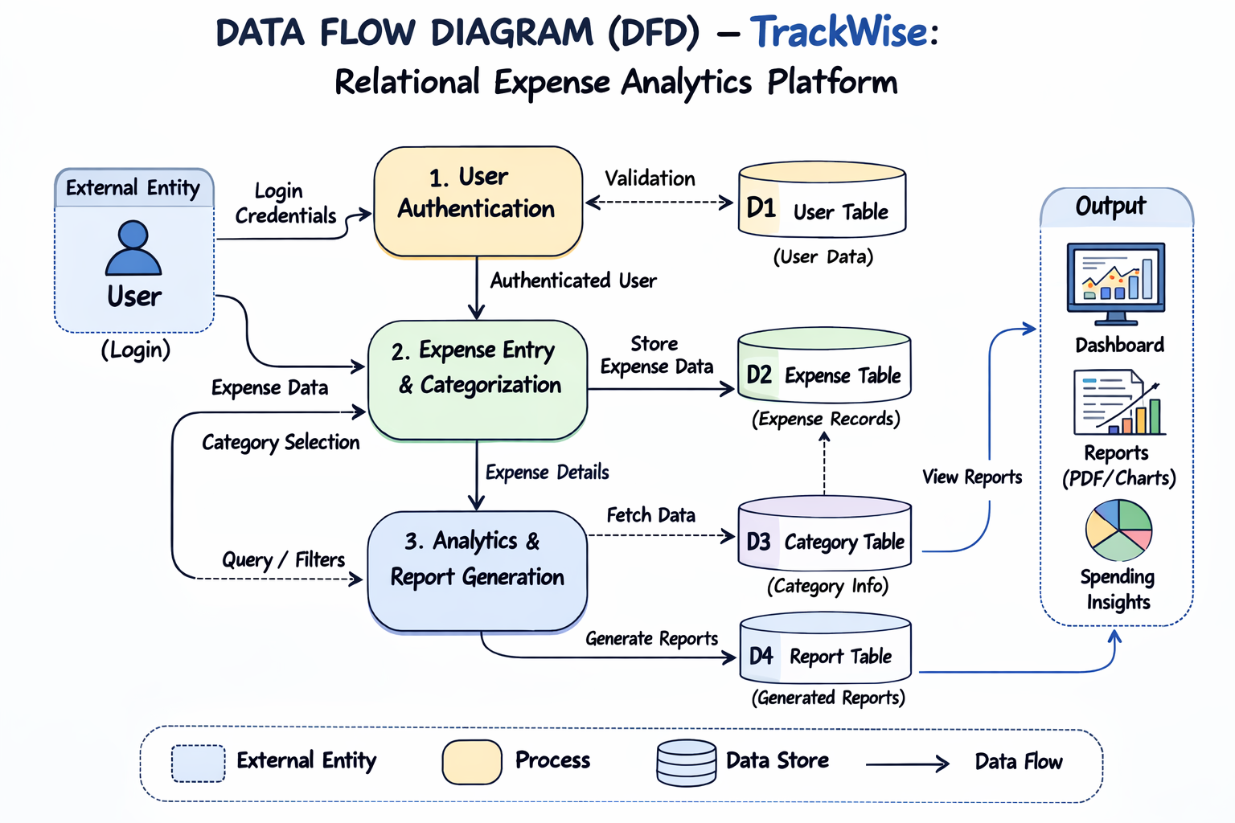
WORKFLOW
1
2
3
4
5
6
7
8
9

Slide 8
TECHNOLOGIES USED
Frontend: HTML5, CSS3 (Flexbox & Grid), and JavaScript (ES6) for building a responsive user interface.
Backend: Node js with Apache Server (XAMPP) for handling server-side logic and data processing.
Database: MySQL relational database for structured storage and management of expense records.
Tools: Visual Studio Code, XAMPP, phpMyAdmin, Git, and Google Chrome for development and testing.
Hardware/Software Requirements: Minimum 4GB RAM, Intel i3 or above, 20GB storage, Windows/Linux OS with XAMPP and a modern web browser
1
2
3
4
5
6
7
8
9

Slide 9
MODULE DESCRIPTION
Module 1: User Management
Manages user registration, login, and session control with secure validation and user-specific data access.
Module 2: Core Processing
Handles expense input, category assignment, validation, and structured storage of financial records.
Module 3: Database Management
Maintains structured tables for users, expenses, and categories while ensuring data integrity and efficient retrieval.
Module 4: Reporting & Analytics
Processes stored data to generate dashboards, category-wise summaries, trend analysis, and financial reports.
1
2
3
4
5
6
7
8
9

Slide 10
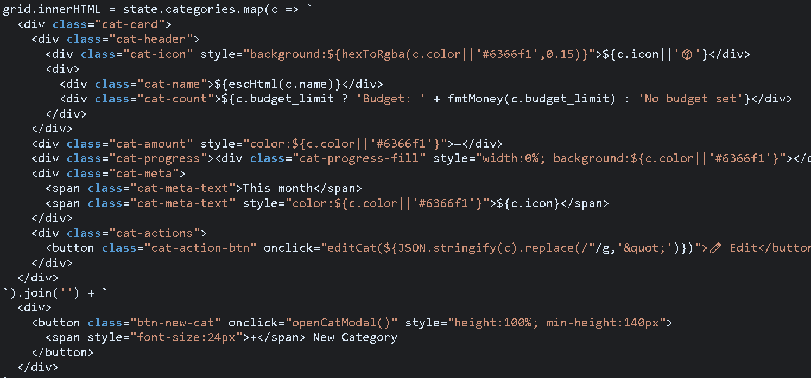
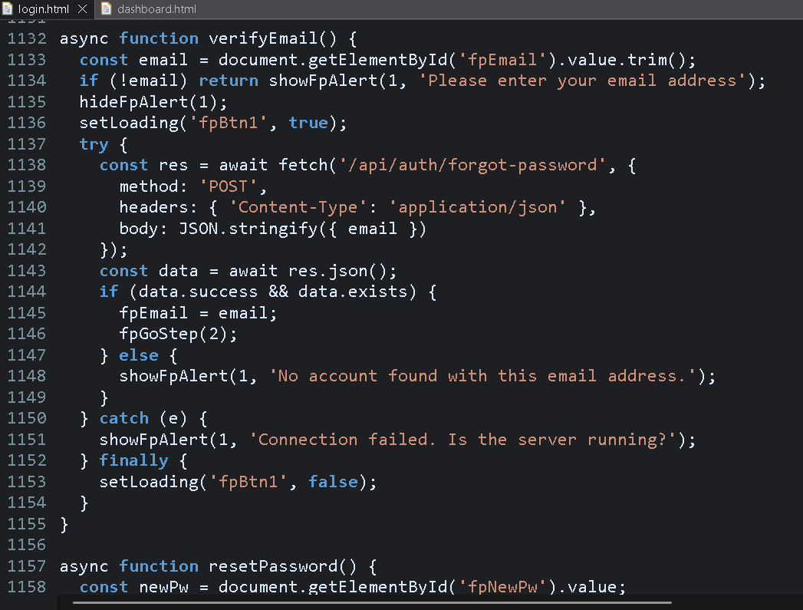
IMPLEMENTATION SCREENSHOTS
Main Module: Allows users to add, edit, categorize, and
manage expenses while processing data
for analytics.
Performs core operations such as expense
recording, updating, deletion, and category
management.
Login Page: Authenticates users by verifying credentials and
grants secure access to their personal expense
data.
Ensures secure user authentication and prevents
unauthorized access to financial records.
1
2
3
4
5
6
7
8
9

Slide 11
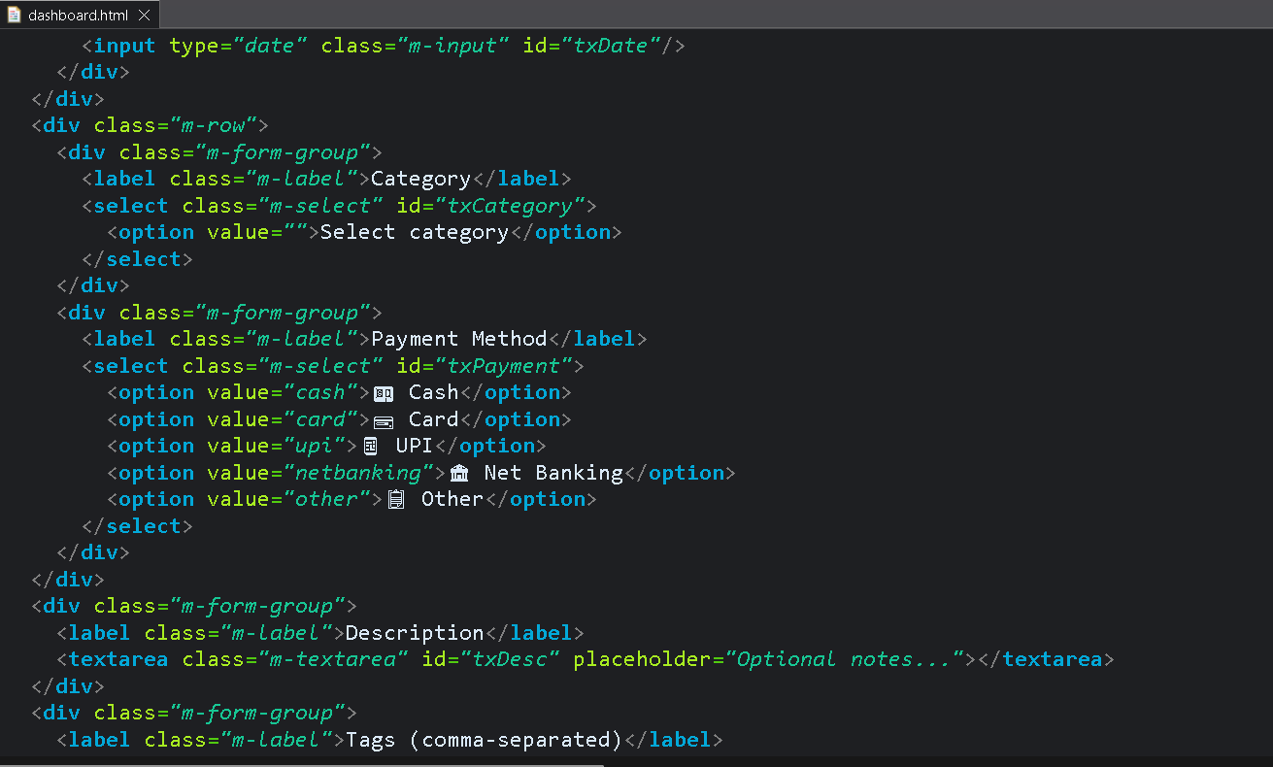
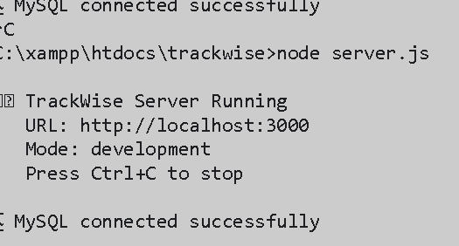
IMPLEMENTATION SCREENSHOTS
1
Home Page: Acts as the entry point of the system, presenting
key features and guiding
users to access the platform.
Provides an overview of the TrackWise platform
with navigation options for login and system
features.
Output Page: Displays dashboards, charts, and financial
reports based on analyzed expense data.
Generates summarized insights, monthly
reports, and visual analytics for informed
financial decisions.
2
3
4
5
6
7
8(A)
9

Slide 12
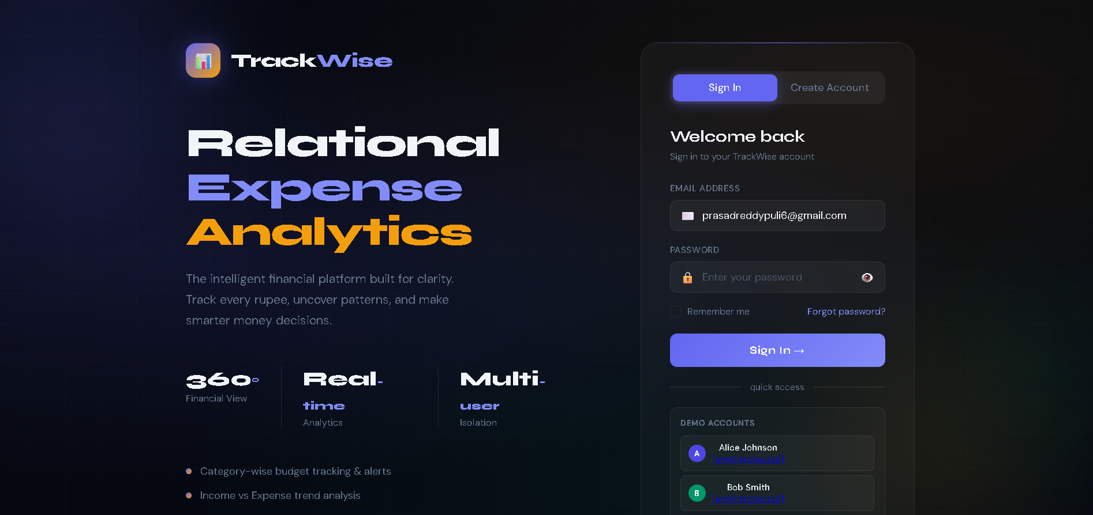
IMPLEMENTATION SCREENSHOTS
1
2
3
4
5
6
7
8(B)
9

Slide 13
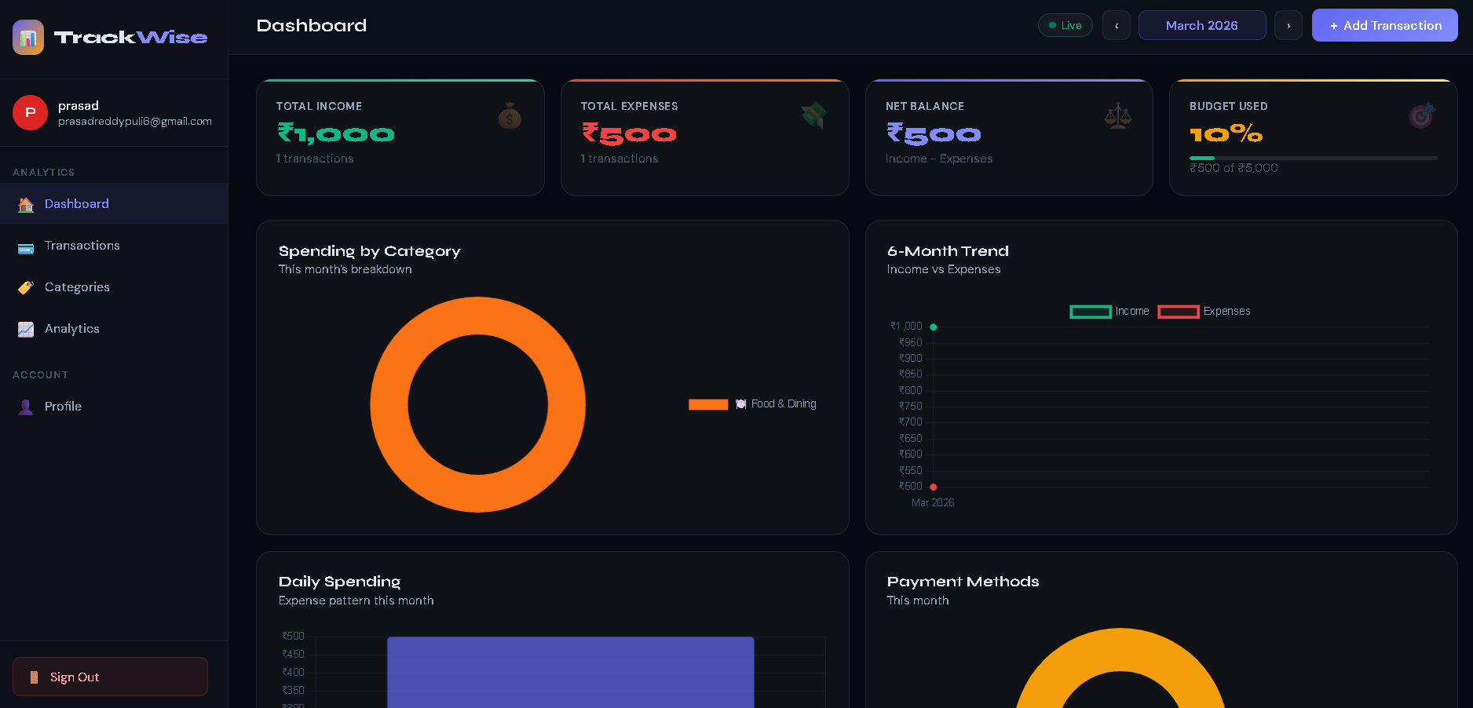
IMPLEMENTATION SCREENSHOTS
1
2
3
4
5
6
7
8(C)
9

Slide 14
ADVANTAGES & LIMITATIONS
1
Advantages:
Centralized system eliminates scattered spreadsheets and manual record-keeping.
Relational database ensures structured, accurate, and consistent data management.
Automated calculations and report generation reduce human errors.
Real-time analytics improves budgeting and financial decision-making.
Secure user authentication protects personal financial data.
Limitations:
Requires basic technical knowledge to operate and maintain the system.
Depends on internet/server availability for access.
Initial setup and database configuration may require technical expertise.
Limited scalability if not deployed on a high-performance server environment.
2
3
4
5
6
7
8
9

Slide 15
Thank you

